Slide 1
MATHEMATICAL PROGRAMMING-II
NITHISH -------- 2010030118
SAI CHATUR ---------2010030565
ANWAR ---------2010030109

Slide 2
OBJECTIVE/STATEMENT
Second order cone programming relaxation of nonconvex quadratic optimization problems

Slide 3
LITURATURE SURVEY
AUTHOR | YEAR | LITURATURE SURVEY
Masakazu Kojima | 2015 | This paper proposes a SOCP (second-order-cone programming) relaxation method, which strengthens the lift-and-project LP (linear programming) relaxation method by adding non-convex quadratic valid inequalities for the positive semidefinite cone involved in the SDP relaxation
FranzRendl | 2019
Rujun Jiang(Fudan University) Duan Li(City University of Hong Kong) | 2019 | Second order cone constrained convex relaxations for nonconvex quadratically constrained quadratic programming

Slide 4
ABSTRACT
Nonconvex minimax separable quadratic optimization problems with multiple separable quadratic constraints and their second-order cone programming (SOCP) relaxations. Under suitable conditions, we establish exact SOCP relaxation for minimax nonconvex separable quadratic programs. We show that various important classes of specially structured minimax quadratic optimization problems admit exact SOCP relaxations under easily verifiable conditions. These classes include some minimax extended trust-region problems, minimax uniform quadratic optimization problems, max dispersion problems, and some robust quadratic optimization problems under bounded data uncertainty. The present work shows that nonconvex minimax separable quadratic problems with quadratic constraints, which contain a hidden closed and convex epigraphical set, exhibit exact SOCP relaxations.

Slide 5

INTRODUCTION
Nonconvex quadratic optimization problems involving multiple quadratic constraints are a class of important and computationally hard global optimization problems that arise in many practical applications. They have been extensively studied in the literature. Especially, in recent years, a great deal of attention has been focused on studying them using their semidefinite programming (SDP) relaxation problems and second-order cone programming (SOCP) relaxation problems [2, 3, 5, 10, 21, 23, 28, 27, 30]
where U is an orthogonal matrix; Σi, i = 1,...,p, and Λj , j = 1,...,q, are diagonal matrices with diagonal elements given by σ1 i ,...,σn i and μ1 j ,...,μn j , respectively, that is, Σi = diag(σ1 i ,...,σn i ) and Λj = diag(μ1 j ,...,μn j ); ai, i = 1,...,p, and bj , j = 1,...,q, are n-dimensional vectors; αi, i = 1,...,p, and βj , j = 1,...,q, are real numbers.

Slide 6
CONVEX OPTIMIZATION
Convex optimization is a subfield of mathematical optimization that studies the problem of minimizing convex functions over convex sets. Many classes of convex optimization problems admit polynomial-time algorithms, whereas mathematical optimization is in general NP-hard.
NON-CONVEX OPTIMIZATION
A non-convex optimization problem is any problem where the objective or any of the constraints are non-convex,. Such a problem may have multiple feasible regions and multiple locally optimal points within each region

Slide 7
Problems in Non-convex Optimization
SOCP relaxations and epigraphical sets.
Minimax uniform quadratic optimization problems.
Minimax QPs with generalized trust-region constraints
Max dispersion problems

Slide 8
MODEL
PANDAS
Numpy
Scipy
cvxpy

Slide 9
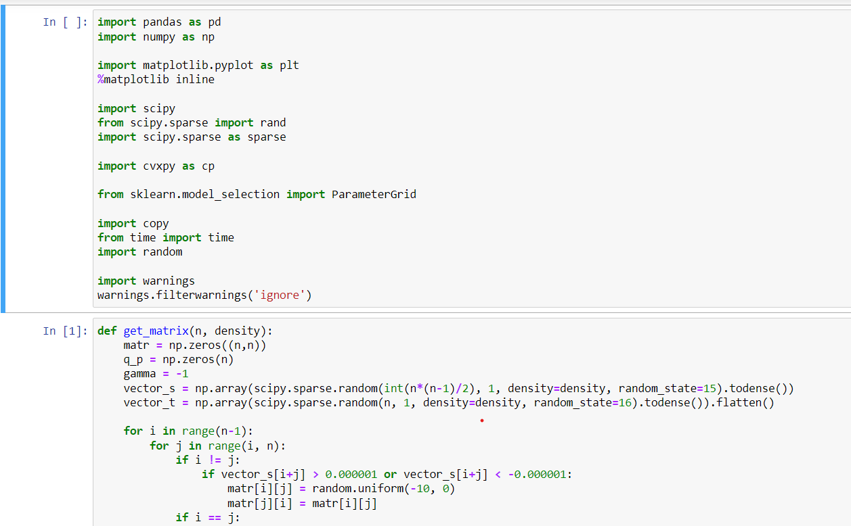
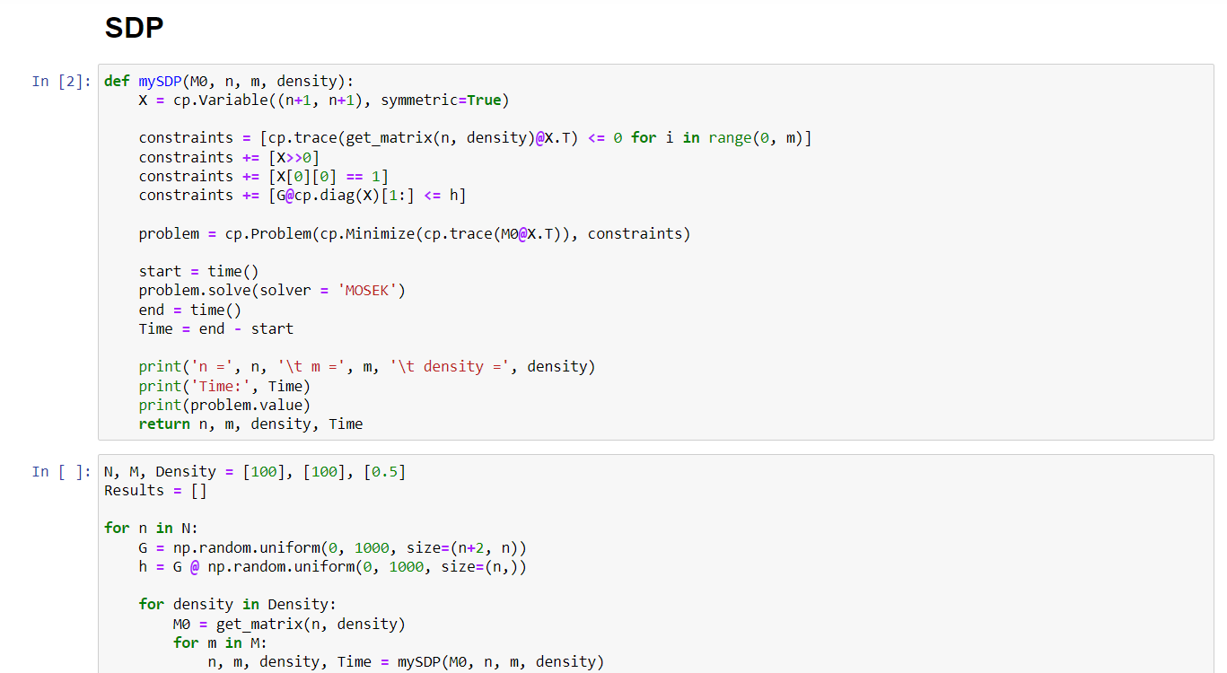
CODE

Slide 10
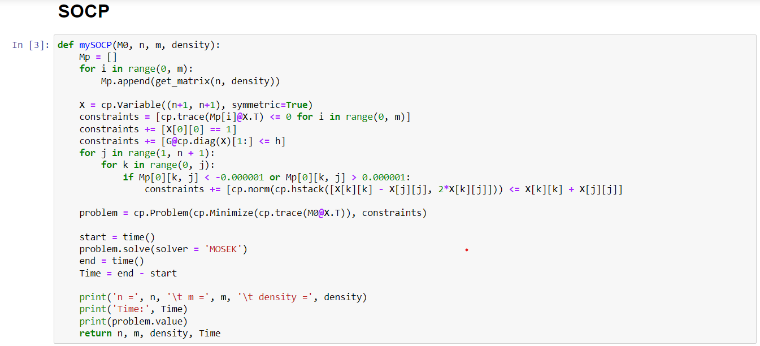
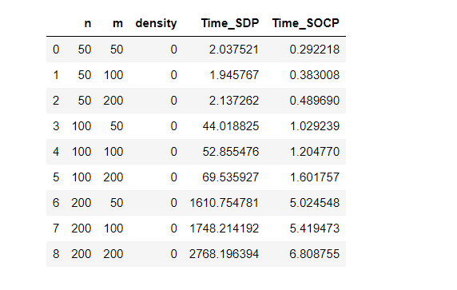

Slide 11
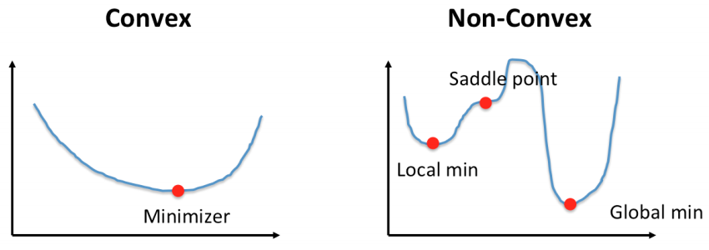
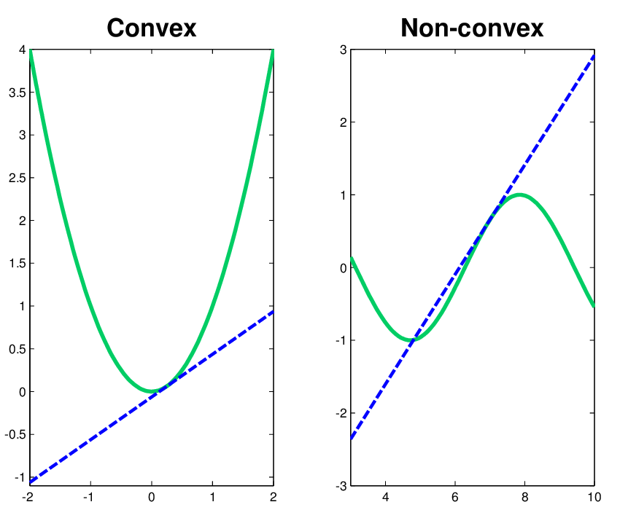
CONVEX AND NON-CONVEX

Slide 12
CONCLUSION
we will established exact SOCP relaxations for nonconvex minimax separable quadratic optimization problems with multiple separable quadratic constraints under an epigraphical condition. We exploited hidden convexity in the form of a convex epigraphical set to achieve our results. We have also provided various classes of minimax problems for which our results hold under easily verifiable conditions

Slide 13
REFERENCES
Anstreicher, K.: Semidefinite programming versus the reformulation-linearization technique for nonconvex quadratically constrained quadratic programming. J. Glob. Optim. 43(2–3), 471–484 (2009)
Michale.: On convex relaxations for quadratically constrained quadratic programming. Math. Program. 136(2), 233–251 (2012)Google Scholar
Masakazu: https://www.proquest.com/docview/215642889?pq-origsite=gscholar&fromopenview=true
Beck, A., Eldar, Y.C.: Strong duality in nonconvex quadratic optimization with two quadratic constraints. SIAM J. Optim. 17(3), 844–860 (2006)Google Scholar
Boyd, S., Vandenberghe, L.: Semidefinite programming relaxations of non-convex problems in control and combinatorial optimization. In: Paulraj, A., Roychowdhury, V., Schaper, C.D. (eds.) Communications, Computation, Control, and Signal Processing, pp. 279–287. Springer, Berlin (1997)
Goemans, M.X., Williamson, D.P.: Improved approximation algorithms for maximum cut and satisfiability problems using semidefinite programming. J. ACM (JACM) 42(6), 1115–1145 (1995)
Pardalos, P.M., Vavasis, S.A.: Quadratic programming with one negative eigenvalue is NP-hard. J. Glob. Optim. 1(1), 15–22 (1991)Google Scholar

